Slide 1
College Campus Digital Network
Out-Of-Home Business Building Idea
12.14.21

Slide 2
IDEA OVERVIEW
Opportunity:
College campus digital network screens are located on over 600 colleges campuses
nationwide. Relevant content for both students and faculty in Real-Time. College students are diverse, tech savvy, socially aware, and want to do business with brands that share their values. They want a positive brand experience before they become brand loyal customers.
Market(s):
Nationwide
Rationale:
Gen Z (born between 1995 – 2010) will account for 40% of the consumer market in 2022. Campus digital screens allow brands a longer dwell time with this audience to story tell and build brand loyalty.
Digital screens encourage student engagement, reaching students in high traffic and high impact areas on campus every day: Food service areas, student centers, student housing, bookstores, retail areas.
Budget: TBD
www.wilkinsmedia.com

Slide 3
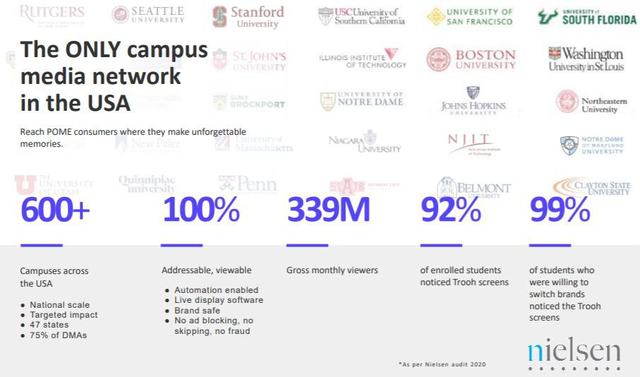
CAMPUS DIGITAL MEDIA NETWORK
www.wilkinsmedia.com

Slide 4
CAMPUS DIGITAL MEDIA NETWORK
www.wilkinsmedia.com

Slide 5
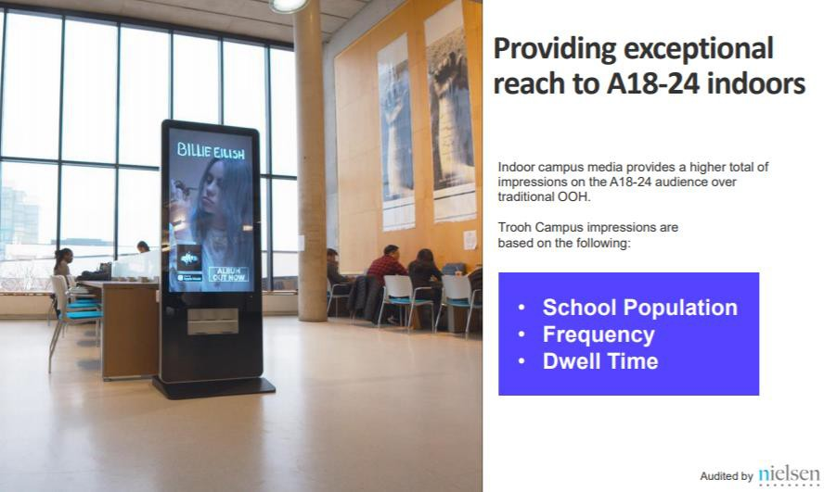
CAMPUS DIGITAL MEDIA NETWORK
www.wilkinsmedia.com

Slide 6
CAMPUS DIGITAL MEDIA NETWORK
www.wilkinsmedia.com

Slide 7
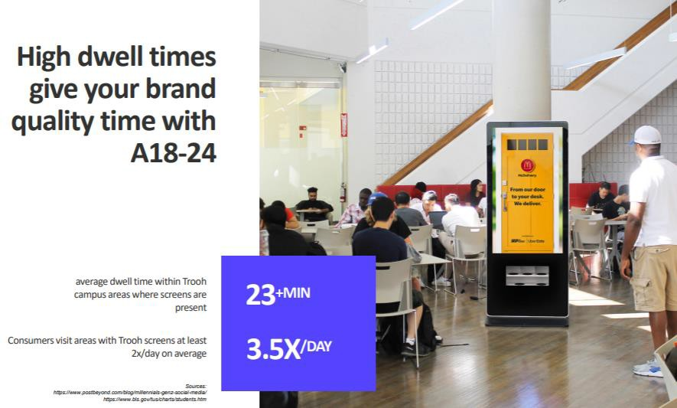
CAMPUS DIGITAL MEDIA NETWORK
www.wilkinsmedia.com

Slide 8
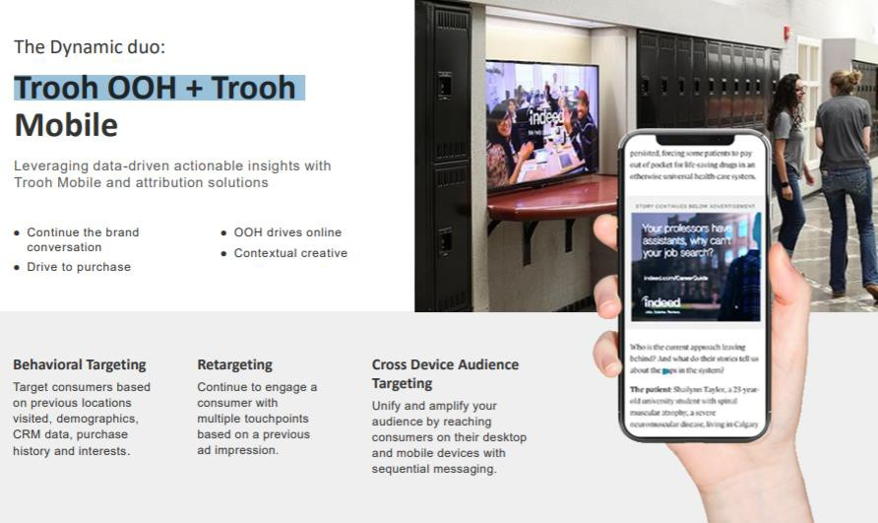
CAMPUS DIGITAL MEDIA NETWORK & MOBILE SOLUTIONS.
www.wilkinsmedia.com

Slide 9
Lori Shearer
Director, Client Partnerships
lori@wilkinsmedia.com
310-877-8240
THANK YOU

