Slide 1
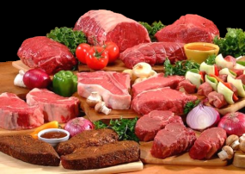
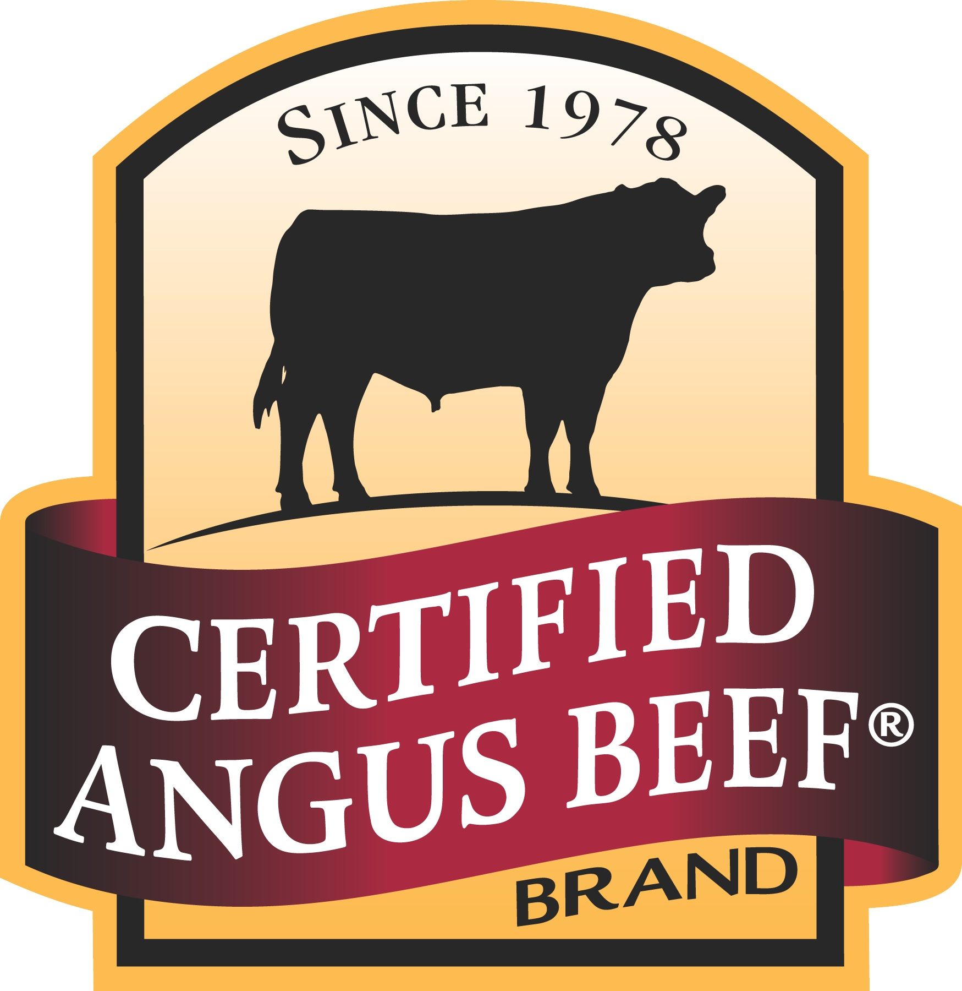
The meat cuts you want at the prices you’ll love!
2350 Spring Rd. and 2148 S. Cobb Dr. ~ ndmmarket.com

